Slide 1
Introduction to python
INSTRUCTOR: WAQAR AAMIR

Slide 2
What is Programming?
Programming is a way to communicate with Computers.

Slide 3
Outline:
Basic Syntax
Variable types
Type Casting
Operators
Decision making
Loops
Lists
Tuples
Dictionaries
OOPs
Functions
File I/O
Exceptions

Slide 4
What is Python?
It was created by Guido van Rossum in 1991.
From Monty circus show
Python is a dynamically typed, General purpose programming language
It supports Object Oriented Programming approach.
Python is an interpreted, High level programming Language.
Portable – work on Linux/Window/Mac.
Downloads: http://www.python.org
Documentation: http://www.python.org/doc/
Free book: http://www.diveintopython.org

Slide 5
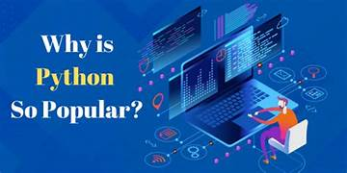
Why is Python?
Simple & Easy to learn
It takes less development time.
Free & Open Source.
Rich Library Support.
Embeddable & Extensible.

Slide 6
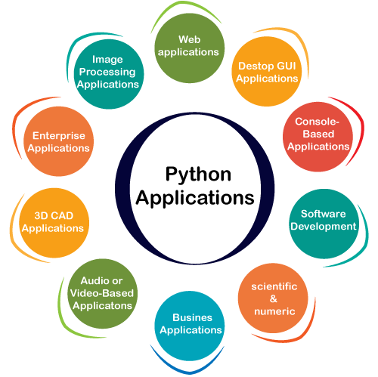
Where is Python?
Web Frameworks & Application.
GUI based desktop Apps
Data Science, Data visualization
Internet of Things (IOT)

Slide 7
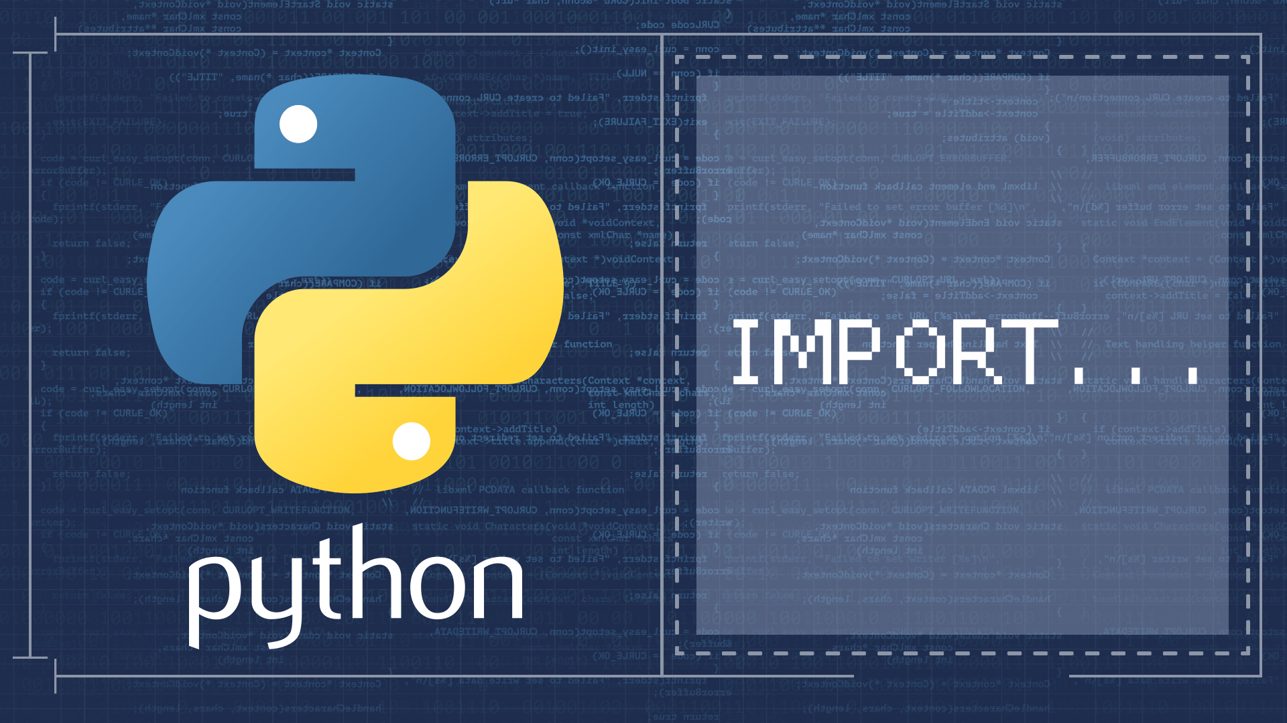
Modules in Python:
Module is a File Containing code written by Somebody else.
It can be a Python definitions & Statements.
It can be imported & used in our programs.
Module’s name is available as a global variable value.

Slide 8
Types of Modules in Python:
In python Modules are of 2 types:
Build-in Modules:
External Modules:
Examples:
OS management, Disk IO, abc, etc
Tensorflow, flask, etc.

Slide 9
PIP in Python:
PIP is the package manager for Python packages.
We can use PIP to install packages that do not come with Python.
The basic syntax of PIP commands in the command prompt is:
Install Package with Python PIP:
‘Pip install flask’
pip 'arguments'

Slide 10
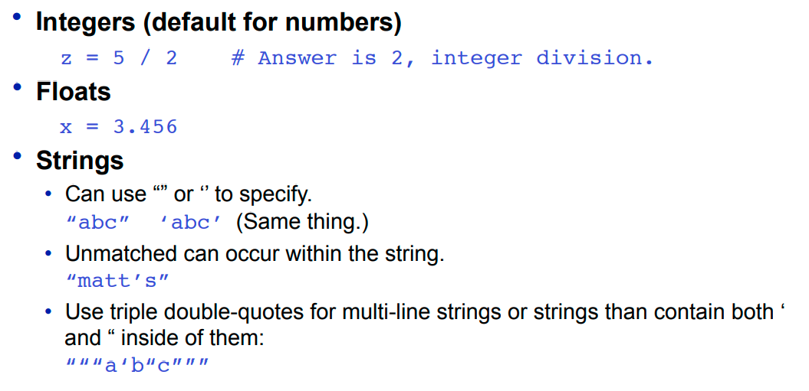
Basic Datatypes:

Slide 11
Data Types:
Mutable Datatypes
Immutable Datatypes
List – []
Sets
Dictionary
Tuples – {}
Strings
Num

Slide 12
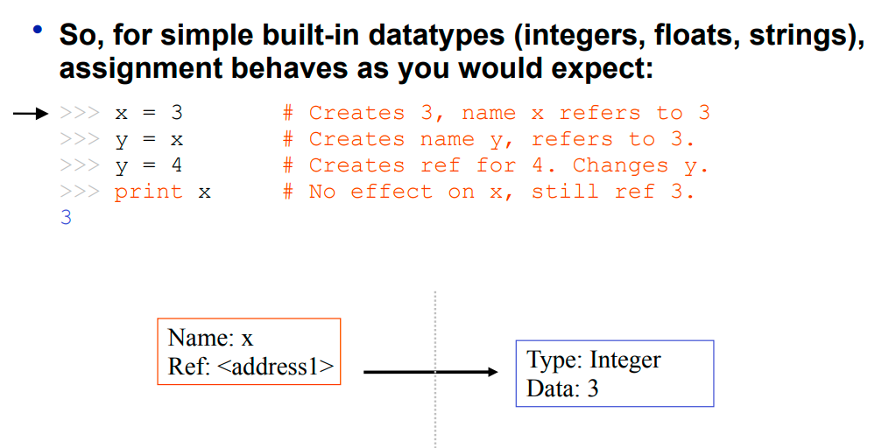
Basic Memory Allocation:

Slide 13
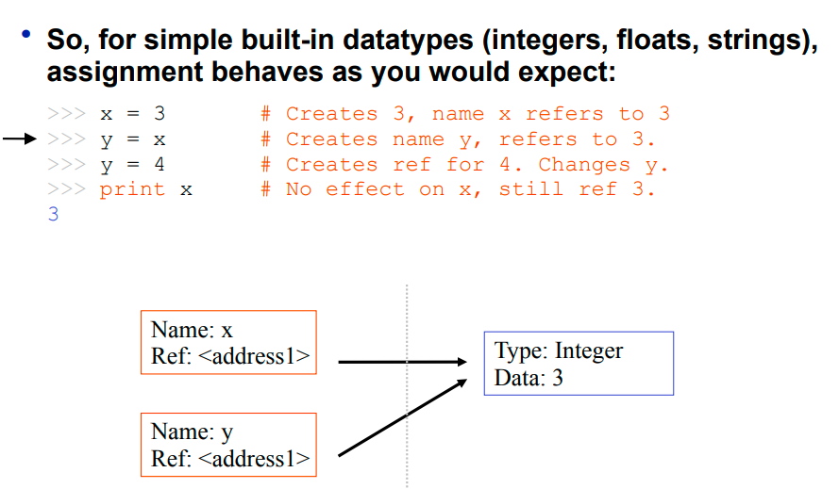
Basic Memory Allocation:

Slide 14
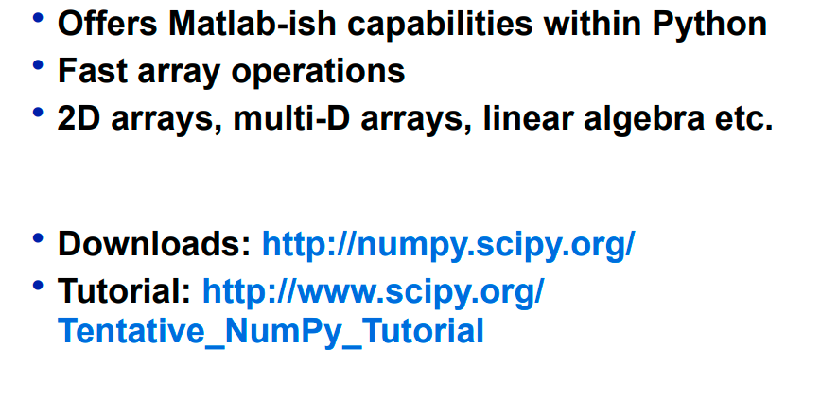
Numpy:

Slide 15
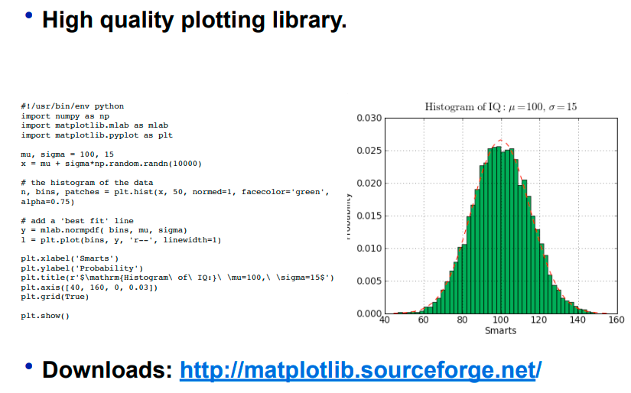
Matplotlib:

Slide 16
Push harder than yesterday if you want a Different Tomorrow..
Thank You ☺

